Slide 1
GRD770: Data Interpretation Basics
Friday: September 3, 2021

Slide 2
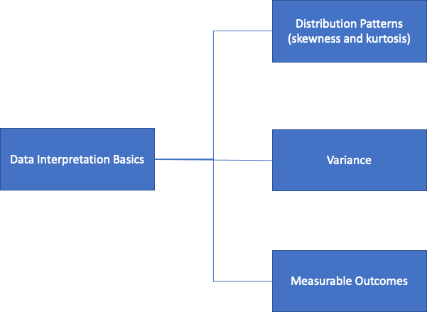
Introduction
Question: What are some factors that you should consider prior to analyzing your data with a certain statistical test?

Slide 3
Group Breakout Assignments
Groups 1 and 4
Generate representative data that depicts:
Negative Skew, Positive Kurtosis
Positive Skew, Negative Kurtosis
Positive Skew, Positive Kurtosis
Negative Skew, Negative Kurtosis
Positive Skew, No Kurtosis
Negative Skew, No Kurtosis
Include Examples of Data Derived From Hypothetical Scenarios That May Account for The Different Distribution Patterns

Slide 4
Group Breakout Assignments
Groups 2 and 5
Generate representative frequency distribution data that depicts:
Small Variance
Large Variance
No Variance
Mean and Median are the Same
Large Mean and Moderate Median
Include Examples of Data Derived From Hypothetical Scenarios That May Account for The Differences in Variance

Slide 5
Group Breakout Assignments
Include :
-Null vs. Alternative Hypothesis
Variables to Explain the Different Outcomes
Plots of Outcome vs. Predictor
Groups 3 and 6
Generate hypothetical scenarios and data
for:
Continuous Outcome
Categorical Outcome
Success/Failure Outcomes
Survival Outcomes

Slide 6

Be prepared to share your groups results and define and facilitate discussion on your assigned topics☺
Notes:
Groups: 4, 2, 6 Present

